Slide 1


Sir James Smith's Tutor Reading Programme
All students in Years 7- 10 participate in tutor reading three times a week for twenty minutes each session. Students are read to by their tutors who model aspects of fluency so that reading becomes as automatic as breathing.
Throughout each academic year, students are introduced a range of texts from different culture and genres. Our Literary Canon has been especially curated to help students develop a love of reading and develop literacy levels. Our tutor reading programme engages with reciprocal reading strategies to help students develop skills to become successful readers. Texts have been selected to support the school's wider curriculum, developing cultural capital and vocabulary through exploring words in context.
By the end of Year 10, Our students will have read a significant number of books with challenging themes and ideas. It is hoped that students will have read at least 16 engaging titles by the age of 16!

Slide 2
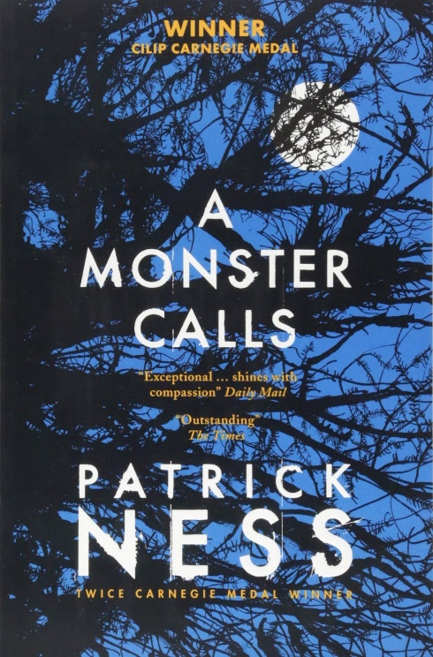

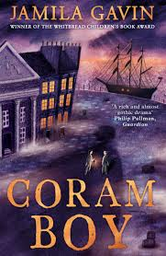
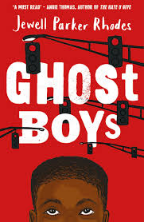
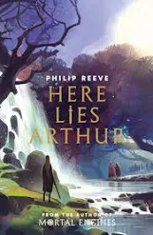
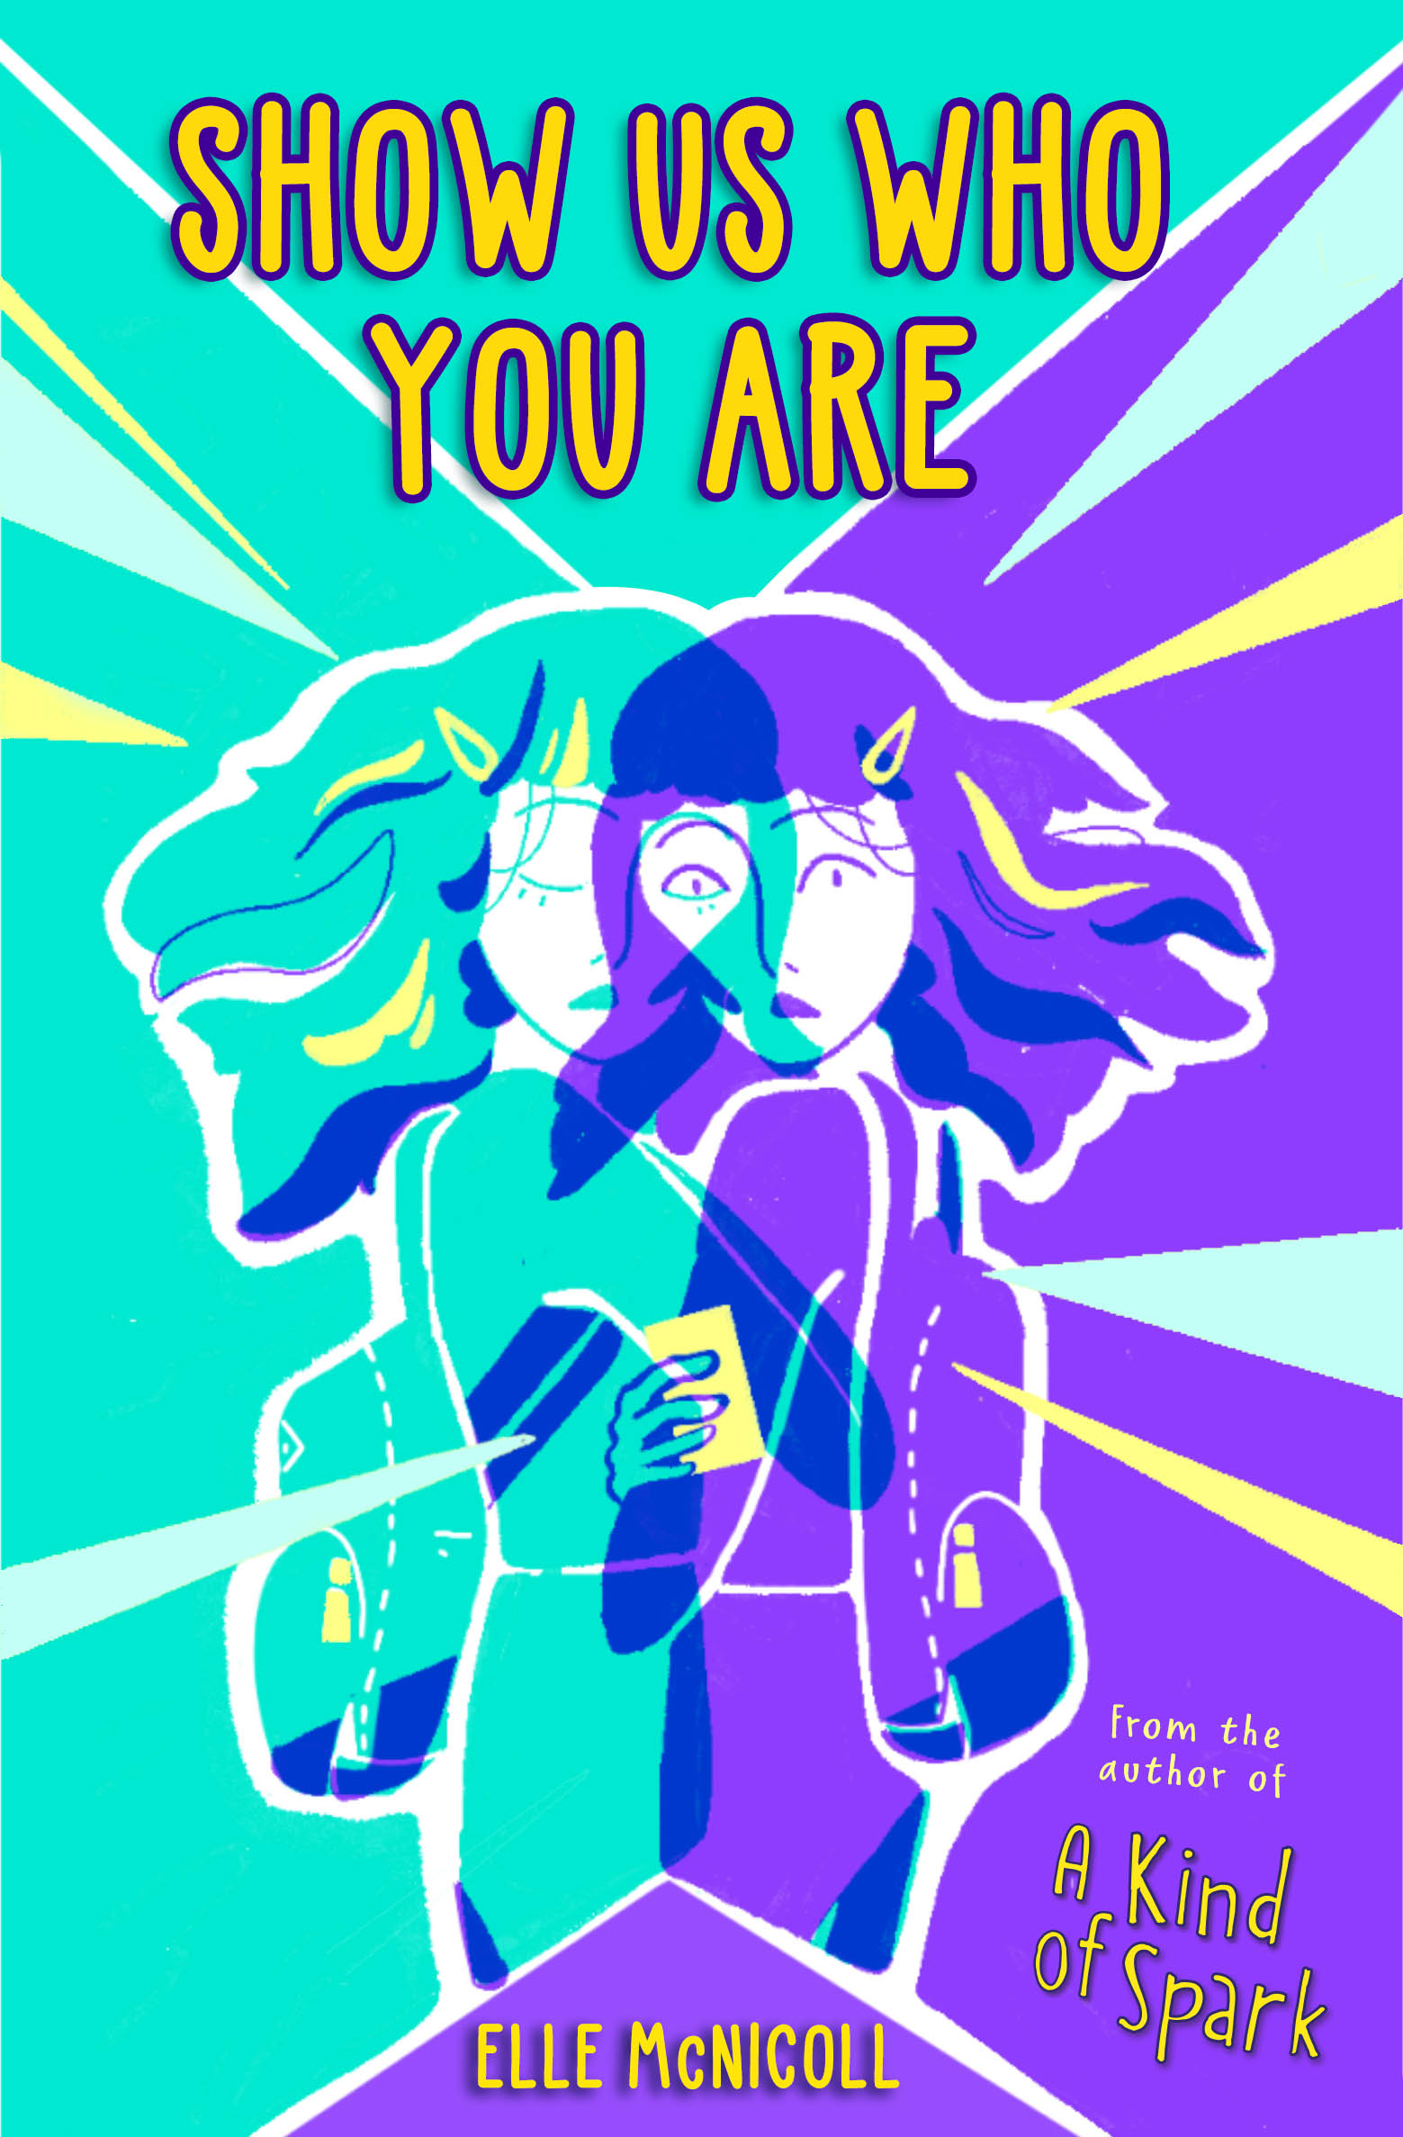
Year 7

Slide 3
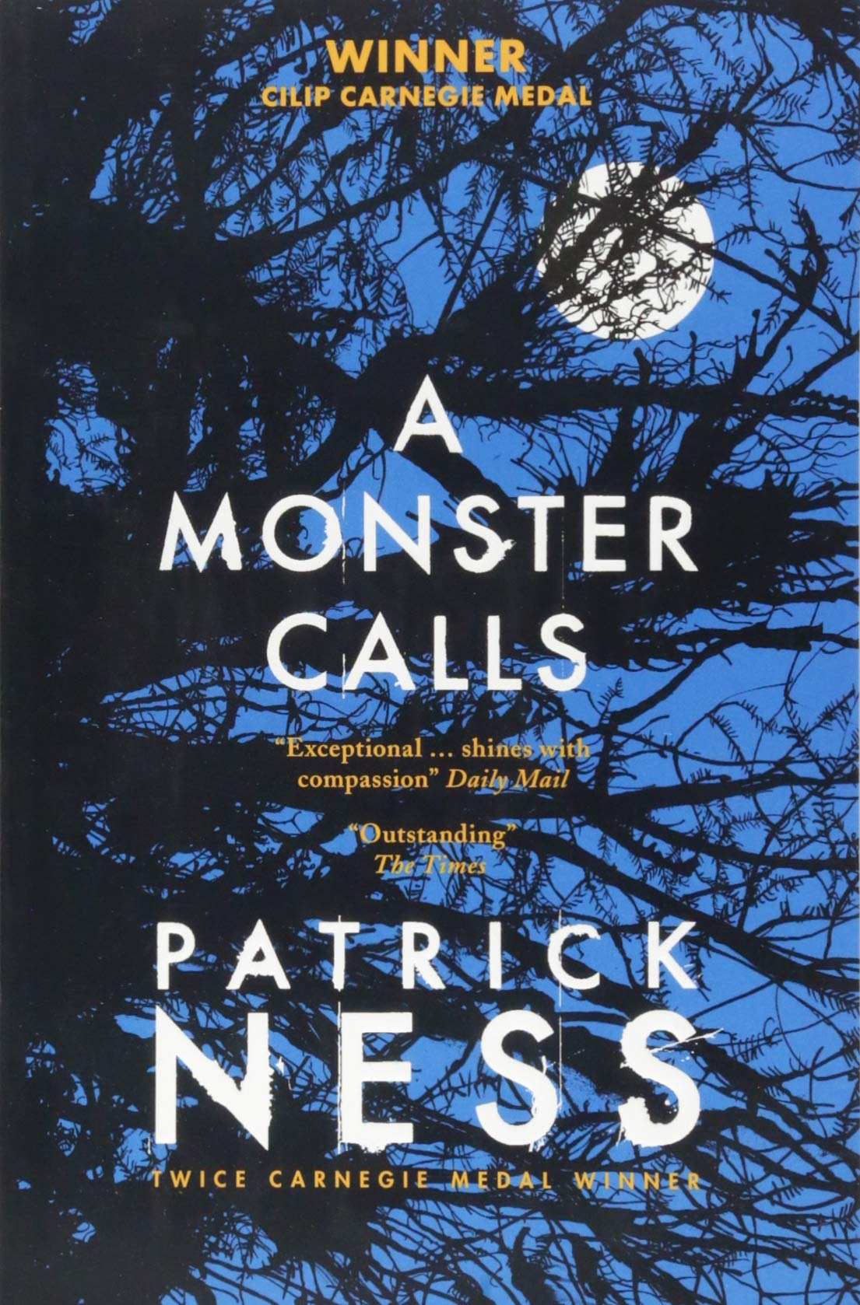
A Monster Calls
Expectations
Sit up straight at your desk​​
Follow my reading with your reading bookmark​​
Listen carefully​​
Learn new vocabulary
- Patrick Ness
A Monster Calls details the story of Conor O'Malley, a 13-year-old boy who is dealing with his mother's illness. Her impending death hangs over the bulk of the book, and Conor must explore his own emotions through stories to find peace in her passing and how he feels about it.
Reading miles: At the end of this book, you will have read 33,446 words.
Themes:
Death
Denial
Isolation
Acceptance
Family

Slide 4
Coram Boy
Expectations
Sit up straight at your desk​​
Follow my reading with your reading bookmark​​
Listen carefully​​
Learn new vocabulary
By Jamila Gavin
Set in the 18th century, it centers around the activities of the Coram Man, who takes babies from desperate mothers. The story focuses on Alexander, a wealthy young man who gives up his money to follow his dream, and Aaron, a boy raised in the Coram Hospital. Both are connected to the mysterious Coram Man and his son, Meshak.
Reading miles: At the end of this book, you will have read 83,637 words.
Themes:
Family and friendship
Courage and loyalty
Exploitation and child cruelty in the 1700s

Slide 5
Show Us Who You Are
Expectations
Sit up straight at your desk​​
Follow my reading with your reading bookmark​​
Listen carefully​​
Learn new vocabulary
Ellie McNicholl
Show Us Who You Are is a heart-wrenching novel full of friendship, grief, and bravery.
The main character, Cora, is autistic and her best friend Adrien has ADHD. The story is set in the near future and is centred around the Pomegranate Institute.​
Reading miles: At the end of this book, you will have read 58,153 words.
Themes:
Friendship
Acceptance
Ethics
Equality
Loss

Slide 6
You Are A Champion
Expectations
Sit up straight at your desk​​
Follow my reading with your reading bookmark​​
Listen carefully​​
Learn new vocabulary
By Marcus Rashford
Marcus Rashford is arguably England’s best-loved footballer; not only for his amazing talent on the pitch, but also for his tireless activism fighting for the rights of children in the UK to receive free school meals over lockdown – which led to a government policy U-turn.
In this book Rashford shows us that anything is possible with hard work, good friends, and a positive attitude.
Reading miles: At the end of this book, you will have read 29,535 words.
Themes:
Good Sportsmanship
Ambition
Self-acceptance and self-esteem
Helping Others
Bravery
Sharing/Teamwork
Self-discipline and self-improvement

Slide 7
Ghost Boys
Expectations
Sit up straight at your desk​​
Follow my reading with your reading bookmark​​
Listen carefully​​
Learn new vocabulary
By Jewell Parker Rhodes
After twelve-year-old Jerome is shot by a white police officer, he observes the aftermath of his death and meets the ghosts of other fallen black boys, including historical figure Emmett Till.
Watch this clip to learn more
Reading miles: At the end of this book, you will have read 20,855 words.
Themes:
Prejudice
Racism
Injustice
Privilege

Slide 8
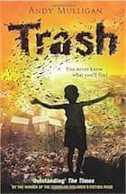

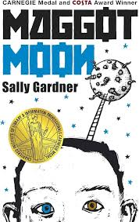



Year 8

Slide 9
Trash
Expectations
Sit up straight at your desk​​
Follow my reading with your reading bookmark​​
Listen carefully​​
Learn new vocabulary
-By Andy Mulligan
Trash tells the story of two fourteen-year-olds, Raphael and Gardo, who team up with a younger boy, Rat, to figure out the mysteries surrounding a bag Raphael finds during their daily life of sorting through trash in a Third World country's dump.
Reading miles: At the end of this book, you will have read 49,937 words.
Themes:
Poverty / Homelessness
Social issues
Friendship
Politics
Waste

Slide 10
I am Malala
Expectations
Sit up straight at your desk​​
Follow my reading with your reading bookmark​​
Listen carefully​​
Learn new vocabulary
Malal Yousafzai
Co-authored by Christina Lamb.
EXPECTATIONS:
Malala Yousafzai describes her fight for education for girls under Taliban rule, the support she received from her parents to pursue an education and how the Taliban retaliated against her by trying to kill her.
Reading miles: At the end of this book, you will have read 90,914 words.
Sit up straight at your desk
Follow my reading with your reading bookmark
Listen carefully
Learn new vocabulary
Themes:
Countries and regions: Pakistan
Religion: different values and beliefs
Community: Human Rights
Social issues: violence and gender inequality
Global issues: Terrorism

Slide 11
His Dark Materials Northern Lights
Expectations
Sit up straight at your desk​​
Follow my reading with your reading bookmark​​
Listen carefully​​
Learn new vocabulary
Phillip Pullman
Lyra Belacqua and her animal daemon live half-wild and carefree among scholars of Jordan College, Oxford. The destiny that awaits her will take her to the frozen lands of the Arctic, where witch-clans reign and ice-bears fight. Her extraordinary journey will have immeasurable consequences.
Reading miles: At the end of this book, you will have read 116,400 words.
Themes:
Science-fiction
Astronomy
Friendship
Adventure
Fantasy

Slide 12
Fight Back
Expectations
Sit up straight at your desk​​
Follow my reading with your reading bookmark​​
Listen carefully​​
Learn new vocabulary
By A. M. Dassu
An empowering story about finding your identity and the courage to fight for it. Aaliyah is an ordinary thirteen-year-old living in the Midlands – she’s into her books, shoes, K-pop and she is a Muslim. She has always felt at home where she lives … until a terrorist attack in her area changes everything.
Reading miles: At the end of this book, you will have read 73,305 words.
Themes:
Friendships and family
Standing up to hate
Harmful stereotypes
Bullying and banter
Emotion, courage and violence

Slide 13
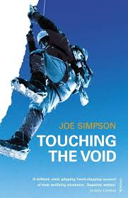
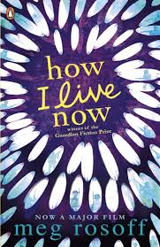

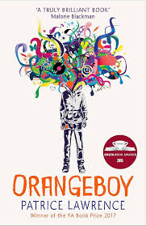
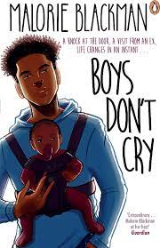
Year 9

Slide 14
Divergent
Expectations
Sit up straight at your desk​​
Follow my reading with your reading bookmark​​
Listen carefully​​
Learn new vocabulary
Veronica Roth
Divergent is a dystopia set in the future in Chicago. 16-year-old Beatrice must choose among a faction, a decision made more difficult when she discovers that she is a does not fit into any one group.
Reading Miles: At the end of this book, you will have read 105,143 words.
Themes:
Identity
Society
Determination and resilience
Family and friendship
Power
Fear and courage

Slide 15
Boys Don't Cry
Expectations
Sit up straight at your desk​​
Follow my reading with your reading bookmark​​
Listen carefully​​
Learn new vocabulary
- Malorie Blackman
Boys Don't Cry is about a seventeen-year-old boy who is shocked to discover he is a father. Caring for the child radically alters his life, and those of his father and younger brother.
Reading miles: At the end of this book, you will have read 68,177 words.
Themes:
Family Life
Teenager life
Gender
Societal norms of masculinity
Single Parents
LGBTQIA+

Slide 16
ORANGE BOY
Expectations
Sit up straight at your desk​​
Follow my reading with your reading bookmark​​
Listen carefully​​
Learn new vocabulary
By Patrice Lawrence
Sixteen-year-old Marlon has made his mum a promise - he'll never follow his big brother down the wrong path. So far, it's been easy, but when a date ends in tragedy, Marlon finds himself hunted. 2017 YA Book Prize winner.
Reading Miles: In reading this book you will have read 93746 words
Themes:
Gang Culture
Family dynamics
Impact of Social inequality
Identity
Consequences of Violence and drugs

Slide 17
Touching The Void
Expectations
Sit up straight at your desk​​
Follow my reading with your reading bookmark​​
Listen carefully​​
Learn new vocabulary
EXPECTATIONS:
Joe Simpson
‘Touching the Void’ tells the story Simpson's harrowing ordeal, in which he broke his leg and fell into a crevasse, and how he survived against seemingly insurmountable odds.
Reading Miles: In reading this book you will have read 71,411 words
Themes:
Adventure-Survival
Places-Canyons/Cliffs/Mountains
Sport/Recreation-Mountaineering
Self – motivation resilience and perseverance
Relationships – friendship and morality

Slide 18


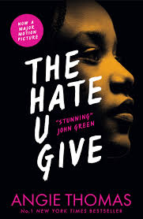
Year 10

Slide 19
The Hitch-Hiker's Guide to the Galaxy
Expectations
Sit up straight at your desk​​
Follow my reading with your reading bookmark​​
Listen carefully​​
Learn new vocabulary
Douglas Adams
The Hitch-hiker's Guide to the Galaxy is an insanely funny, satiric bestseller about the end of the world and the days that follow it. Authur Dent must find a new home after the world is destroyed, to make way for the new hyperspatial express route
Reading Miles: In reading this book you will have read 46,333 words
Themes:
Meaninglessness and Happiness. ...
Power and Control. ...
Improbability, Impossibility, and Absurdity. ...
Knowledge and Exploration. ...
Language and Communication..
Adventure and travel
Science-fiction

Slide 20
The Five
Expectations
Sit up straight at your desk​​
Follow my reading with your reading bookmark​​
Listen carefully​​
Learn new vocabulary
By Hallie Rubenhold
The Five has completely changed the narrative of the Ripper murders. As an investigation into these women’s experiences, it traces the surprising triumphs and heart-breaking difficulties they encountered throughout their lives.
Reading Miles: In reading this book you will have read words
Themes:
Poverty
Victorian Society
Moral and social attitudes
History

Slide 21
THUG
Expectations
Sit up straight at your desk​​
Follow my reading with your reading bookmark​​
Listen carefully​​
Learn new vocabulary
By Hallie Angie Thomas
The Hate U Give is a 2017 young adult novel by Angie Thomas. It is Thomas's debut novel, expanded from a short story she wrote in college in reaction to the police shooting of Oscar Grant. The plot contains violence and pervasive profanity.
Reading Miles: In reading this book you will have read 95,981 words
Themes:
Social issues
Racism
Violence

