Slide 1



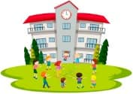










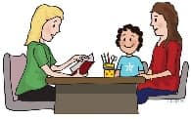



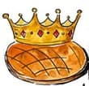







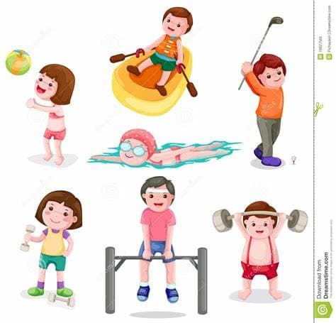







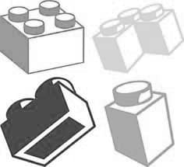



MFL Learning Journey
Apply to study French A Level at South Dartmoor Sixth Form
Module 8: The environment and global issues
Revise for and sit your Y11 mock exams
Module 6:
School
Assess
Assess
Assess
YEAR
11
Have a careers interview and consider where languages could take you
Prepare for speaking exam, revise for listening, reading and writing exams
Develop good MFL revision habits
Module 7: Future aspirations
Module 5:
Holidays
Y10 work experience
Talk about school and differences in France.
Talk about our environment
Discover cultures and traditions from the French-speaking world
Module 4: Town and region
Embed excellent study habits and get ahead with revision
Assess
Complete Y10 mock exams to get GCSE ready
YEAR
Assess
Assess
10
Assess
Assess
Attend GSCE Options assemblies, interview and progress evening
Assess
Module 3:
Daily routines and celebrations
Make your informed GCSE option choices
Talk about identify, self and others
Module1:
Who am I?
Module 2:
Leisure time
Start to think about a GCSE in MFL
Make comparisons; people and things
Talk about a typical day
Celebrate some French New Year’s traditions
Learn about jobs
What, when, where and how we celebrate
YEAR
9
Assess
Assess
Assess
YEAR
8
Talk about what you and others do at school; describing your school experience
Win praise points in an MFL competition
Talk about what you are doing today vs. what you did yesterday
Assess
Celebrate European Day of Languages
Say what activities people do
Learn about ‘having’ and ‘being’
Learn about how Christmas is celebrated in France
Talk about travel
Express future intentions
Assess
Assess
Describe a thing or a person
Learn about activities with the verb ‘doing’
Receive a praise postcard or a progress praise assembly nomination for MFL
Common present tense verbs and intonation questions
Learn about essential irregular verbs and negation
Ask questions in French
YEAR
7
Apply for a place at South Dartmoor
Visit the MFL department during our Open Evening
Develop a curiosity for other cultures
Attend Y6 transition days and meet your MFL teachers
PRIMARY
SCHOOL
Build a solid foundation in language learning and learn how to be a linguist
Sit SATS in
Y6
Explore our online Super Curriculum to begin your secondary MFL experience
The beginning of a lifelong love of language learning
‘To nurture confident linguists and curious global citizens’

