Slide 1




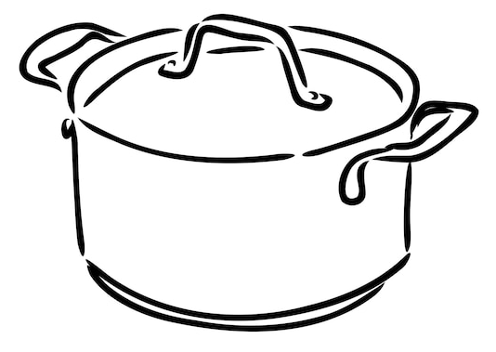


Catering Learning Journey
How can a dish be adapted to suit a customers requirements?
What dish would be suitable for a vegan?
How can cooking methods affect the nutritional value of food?
How can high skills be included in a dish??
Revision
Chapter 3&4
Revision
Chapter 1&2
Pre-Release
NEA
How do you deep fat fry safely?
How is bacteria used to make yogurt?
What is the job role of a contract caterer?
How are a customer's nutritional needs?
How does fermentation make bread rise?
High Skilled Dishes
What is the role of the Environmental Health Officer ?
What is lamination?
Explain the purpose of Minerals in the diet ?
How does emulsification work in a mayonnaise ?
What are customer requirements?
Food Safety
Importance of Nutrition
11
Hospitality and Catering provisions
How is bacteria used safely?
How do you create balance meals?
Where are vitamins and minerals found?
What are the 14
allergens?
Which food bank ingredients have you used?
Describe coagulation in the carbona?
What is pasteurisation ?
Why can’t some people eat blue cheese?
How do you menu plan for a dietary requirement?
Hospitality & Catering Industry
10
What are the roles of front and back of house?
Design, make and evaluate
Safe use of bacteria
What is the difference between commercial and non-commercial?
Why have you picked this dish?
What bacteria is added to cheese?
How does a production plan help make a dish?
What is pathogenic bacteria?
How does pathogenic bacteria cause illness?
Describe the milliard reaction in the chilli?
9
High Risk Food
Design, make and evaluate
Microbes
Pathogenic bacteria
Which country is your dish from?
What conditions do microbes need to grow?
What are visible symptoms of food poisoning?
Why is chicken a high-risk food?
How does seasonality affect food choice?
What food rules do Hindu’s follow?
How can bacteria spread?
Which chopping board is used for raw meat?
What does gluten free mean?
Allergies and intolerances
Food Choice
Cross Contamination
How can dairy be replaced in the cookie practical?
What food does a Vegan avoid?
What is pathogenic bacteria?
International Cuisine
What is lactose intolerance?
Name traditional dishes from Italy
What is the function of water in the diet?
What does the rubbing in method do?
Health Issues
Cooking methods
8
How does steam make the muffins rise?
Diets for different age groups.
Why is calcium important for young children?
How can your diet lead to health problems?
How does denaturing change the texture of meat?
What are the main food groups on the Eatwell plate?
What is cross contamination?
Where do you find Vitamin A?
Vitamins and minerals
Principles of nutrition
Health & Safety in the kitchen
7
What is the function of carbohydrates in the diet?
How is pasta rehydrated when making pasta salad?
How do we stay safe in the kitchen?
Introduction to Catering
Practical Knowledge
Food Choice
Nutrition
Science of Food
Catering & Hospitality

